Slide 1
CSE : Microprocessor
Syed Shakil Mahmud
Lecturer
Department of Computer Science and Engineering
BAIUST

Slide 2
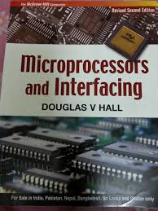
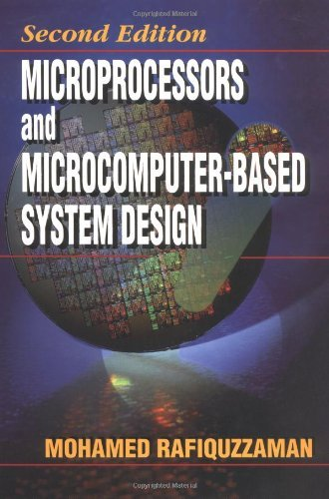
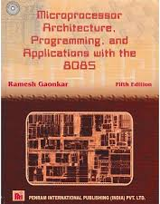
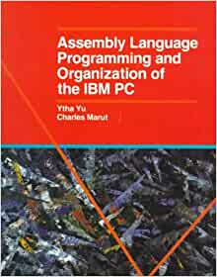
Books Recommended
Microprocessors and Interfacing, Mc GrawHill
1987 By D.V. Hall
2. Microprocessor and Microcomputer Based
System Design By Md. Rafiquzzaman
Microprocessor Architecture, Programming
and Applications with the 8085
By Ramesh Gaonkar
Assembly Language Programming Organization
of the IBM PC
By Ytha Yu, Charles Marut

Slide 3
Lecture 1: Introduction
Introduction to Microprocessor

Slide 4
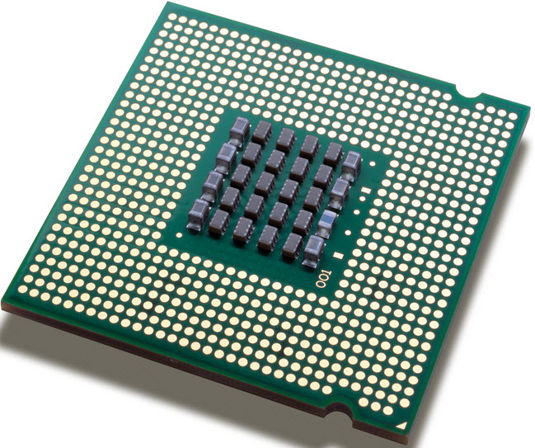
Concept of Microprocessor
The microprocessor (sometimes abbreviated as μP) is one of the most important components of a digital computer.
It acts as the brain of the computer system.
As technology has progressed, microprocessors have become faster, smaller and capable of doing more work per clock cycle.

Slide 5
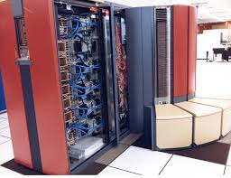
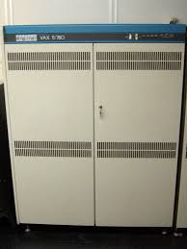
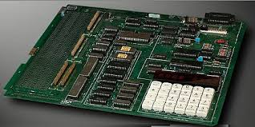
Concept of Microprocessor
Types of Computer:
Mainframe Computers
- IBM 4381, Honeywell DPS8, Cray Y-MP/832
Minicomputers
- VAX 6360, MV/8000II
Microcomputers
- Intel 8051, Intel SDK-86, IBM PC
(a)
(b)
(c)

Slide 6
Concept of Microprocessor
How Computers and Microcomputers are used?

Slide 7
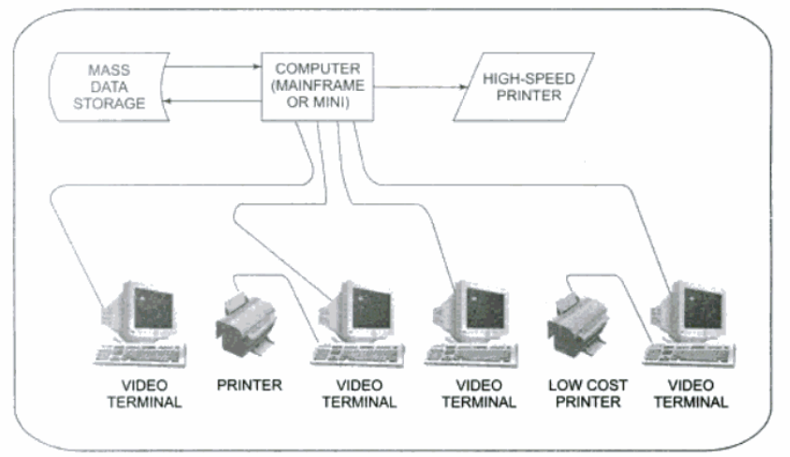
Concept of Microprocessor
Timesharing System:

Slide 8
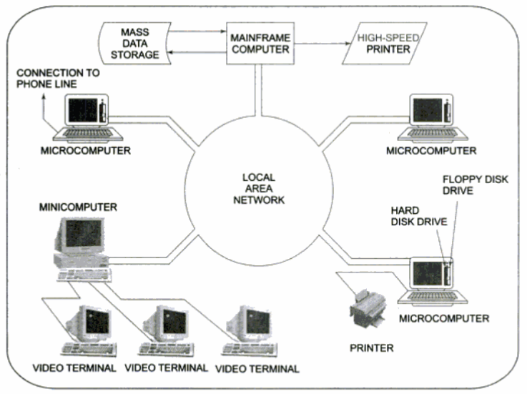
Concept of Microprocessor
Distributed Processing or Multiprocessing Computer System:

Slide 9
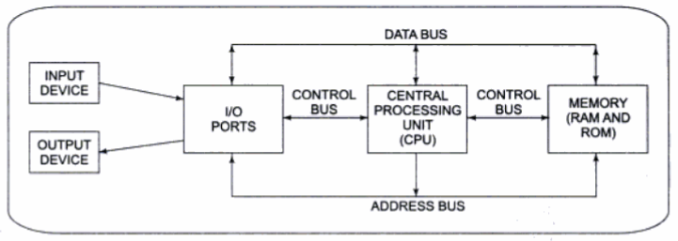
Concept of Microprocessor
Block Diagram of a Simple Micro-Computer
As the name implies, microcomputers are small computers.
The block diagram of the microcomputer is similar to the computer except that the central processing unit of the microcomputer is contained in a single IC called the microprocessor.

Slide 10
Concept of Microprocessor
Hardware
Software
Firmware

Slide 11
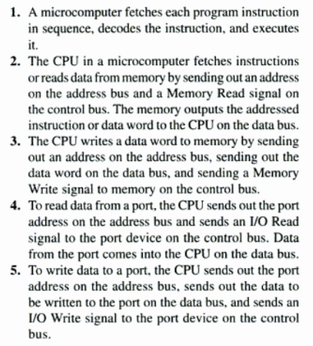
Operation of a Simple Microcomputer Bus
Notes:
Simply follows a sequence:
Fetch, Decode and then Execute

Slide 12
Homework
What determines whether a microprocessor is considered an 8-bit, a 16-bit or a 32-bit device?

